Slide 1

Analysis of cellular responses (Cell detection and segmentation) using deep learning based feature extraction, observation of cell morphology during hypoxia conditions
Guides: dr. Lopamudra Mam, dr. Kishalay Sir

Slide 2
Index
Problem Definition
Challenge
Literature Review
Preliminary Results

Slide 3
Problem Definition
This project aimed to detect and analyze a specific insect cell line, SF21 cells, using only a small dataset of images from our laboratory
Objectives:
Accurately localize individual cells in unseen SF21 images
Determine the correlation between cell diameter and protein expression in infected vs non-infected states.

Slide 4
Challenge
Very limited size of dataset:
Total Dataset Size: 48 images
Control Images: 16 Images
Infected Images: 32 images
Cells are almost round in nature, and we are attempting to accurately detect cells with minimum labelled dataset

Slide 5
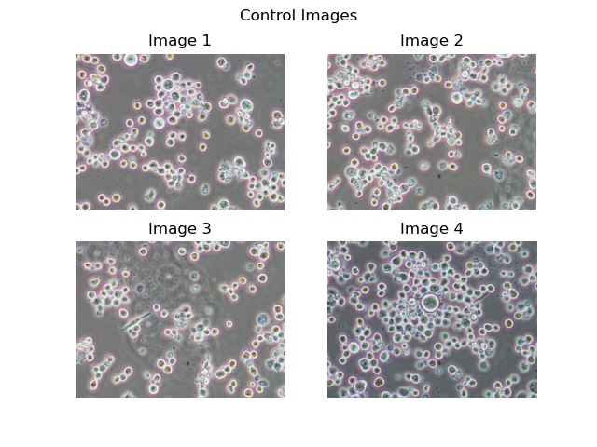
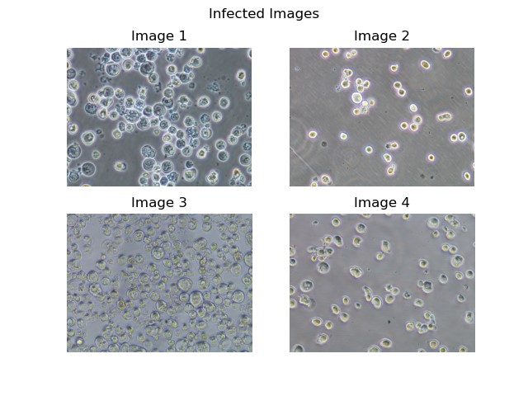
Visualizing the data

Slide 6
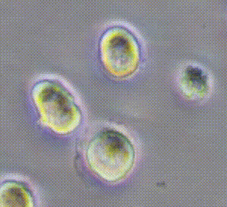
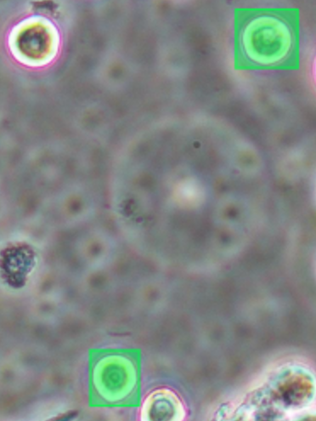
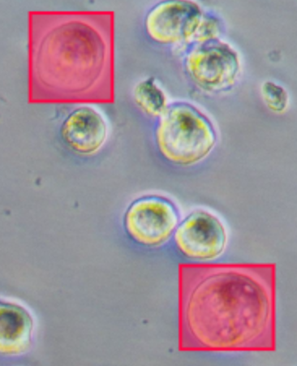
Manual inspection of Infected and Control Diameter
Control
Mean Dia: 110.08
Infected
Mean Dia: 173.22

Slide 7
Literature Review
Histograms of Oriented Gradients for Human Detection -Navneet Dalal and Bill Triggs – July 2005
Deep Residual Learning for Image Recognition (ResNet) – December, 2015
Comparison of HOG, MSER, SIFT, FAST, LBP and CANNY features for cell detection in histopathological images - 1 Şaban Öztürk – February, 2018
Focal Loss for Dense Object Detection(RetinaNet) – Tsung-Yi Lin -February, 2018

Slide 8
Object Detection Framework
Prepare Dataset Cell and No Cell (64x64)
Train Classifier (Detects if cell is present or not)
Run Sliding Window (on full image and run Classifier)
Draw Bounding Boxes (Extract Diameters)
Extract Features (Using feature extraction methods)

Slide 9
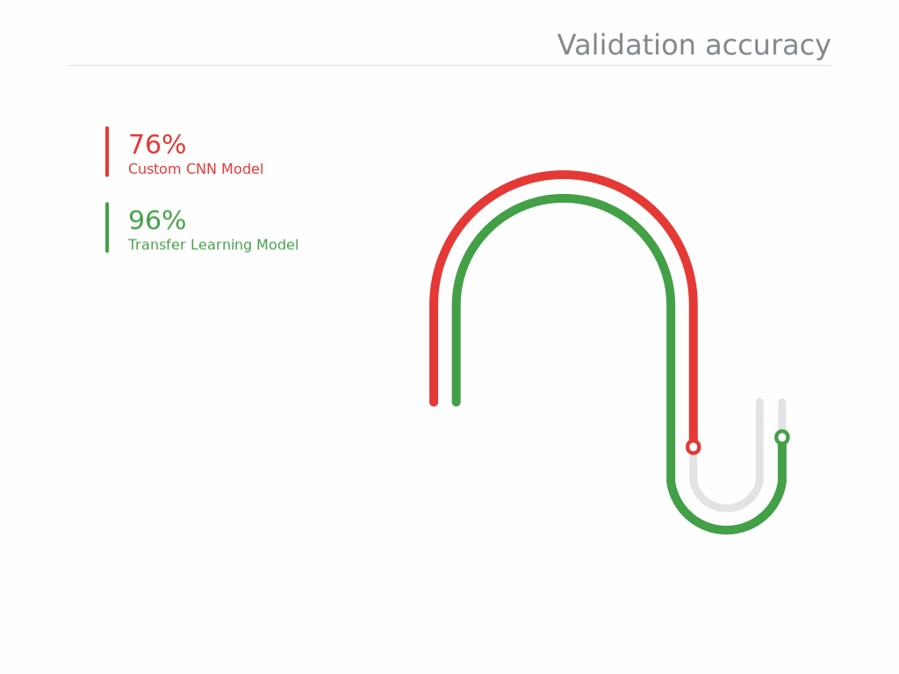
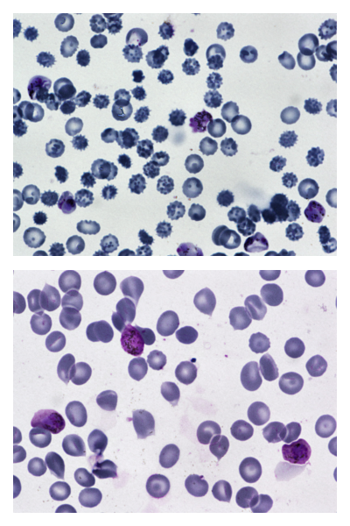
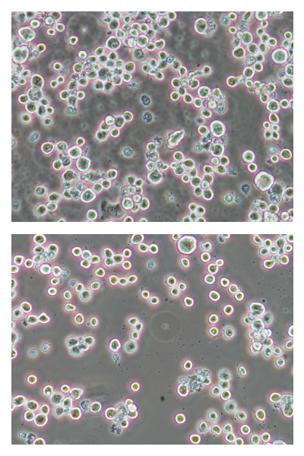
Preparing Dataset
Finding a cell dataset that are similar in shape
and size:
1. Malaria Dataset

Slide 10
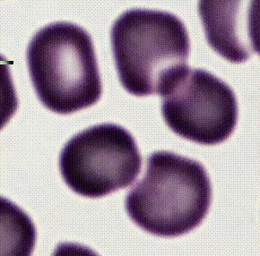
Size of Dataset
No. of Malaria images: 1210 Malaria Images
Mean size of each malaria cell: 98.145

Slide 11
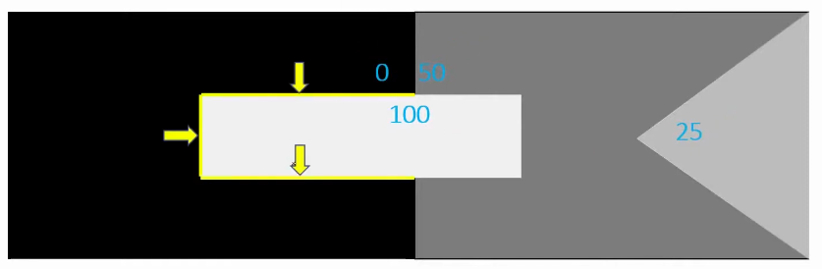
Feature Extraction
HOG Algorithm
Histogram of oriented gradients

Slide 12
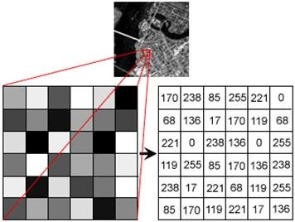
Hog Algorithm
34 | 221 | 0
51 | 51 | 68
136 | 255 | 255
Gx
255 | 221 | 0
170 | 119 | 68
136 | 0 | 255
85 | 102 | 68
34 | 119 | 187
136 | 0 | 255
Gy

Slide 13
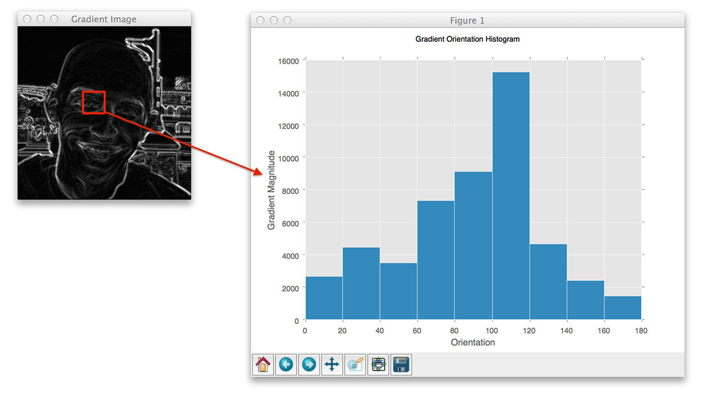
Hog Algorithm
Magnitude Matrix | 92 | 243 | 68
 | 61 | 129 | 199
 | 192 | 255 | 361
Angle Matrix | 68 | 25 | 0
 | 34 | 67 | 70
 | 45 | 0 | 45

Slide 14
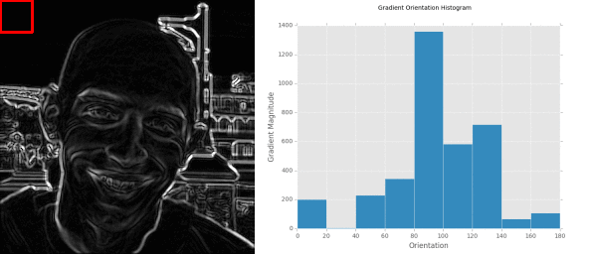
HOG- Intuition

Slide 15
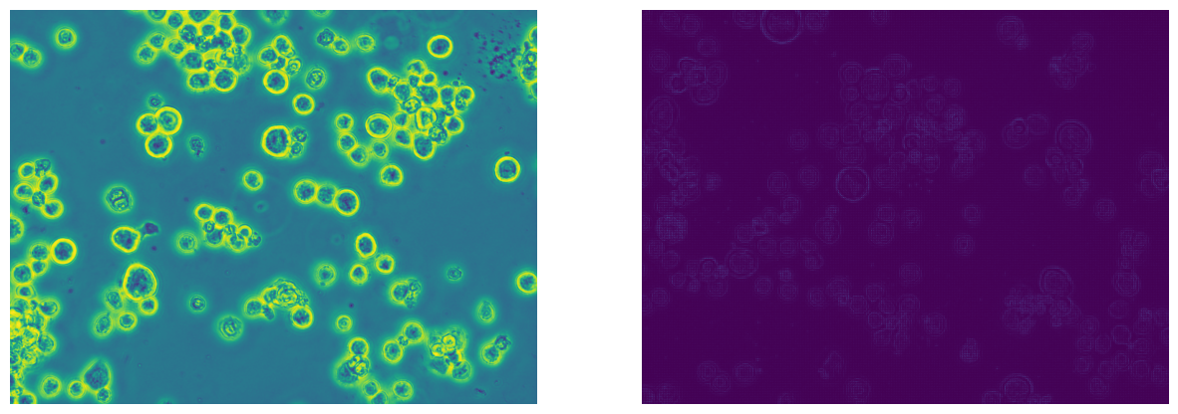

Application of HOG on dataset

Slide 16
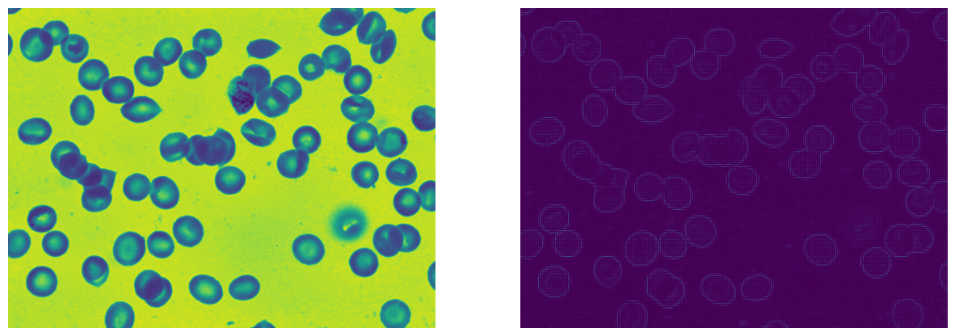
Application of HOG on malaria dataset

Slide 17
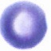
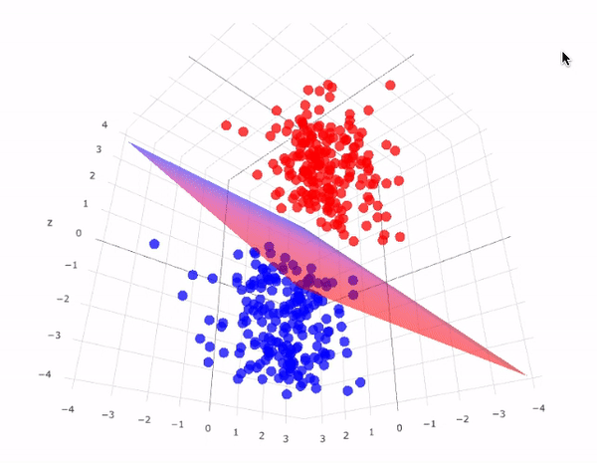

Training Classifier (SVM)
0 – No Cell
1 - Cell
Support Vector Machine

Slide 18
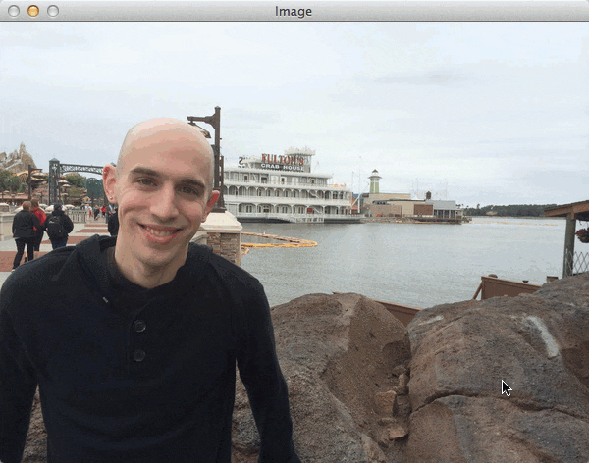
Object Detection
Sliding Window
Resize Window to 64x64
Apply HOG
Feed into classifier
Draw bounding box

Slide 19
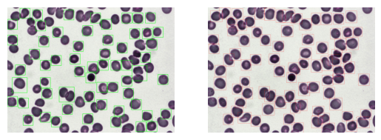
Results on train dataset
Detected
Original

Slide 20
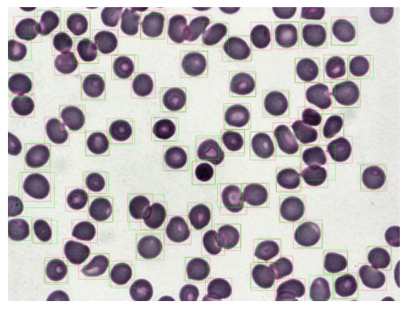
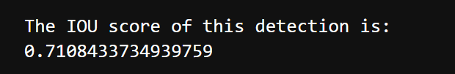
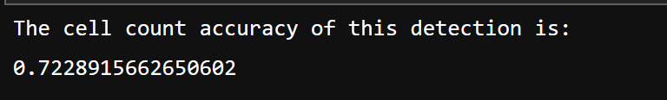
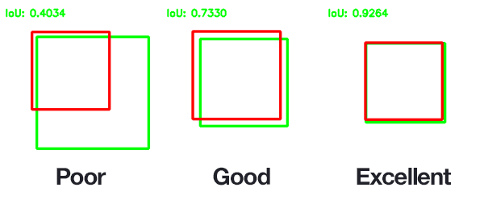
Image Merged over each other
Results:
Image merged over each other

Slide 21
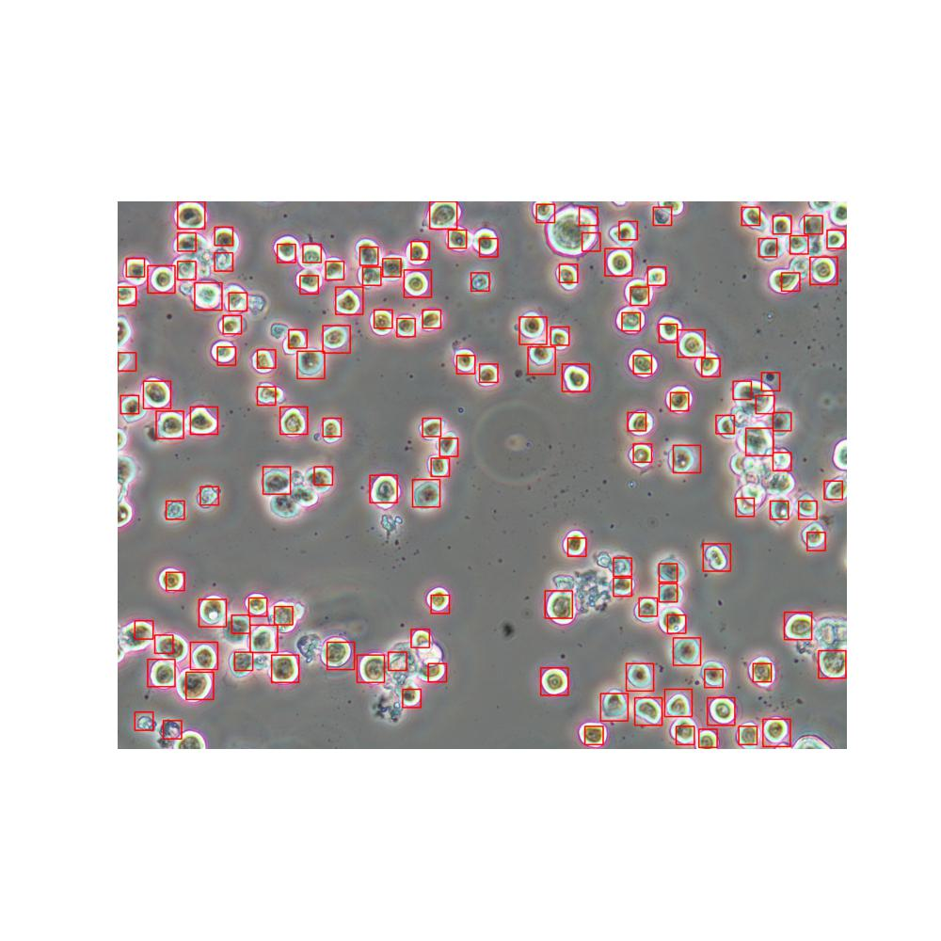
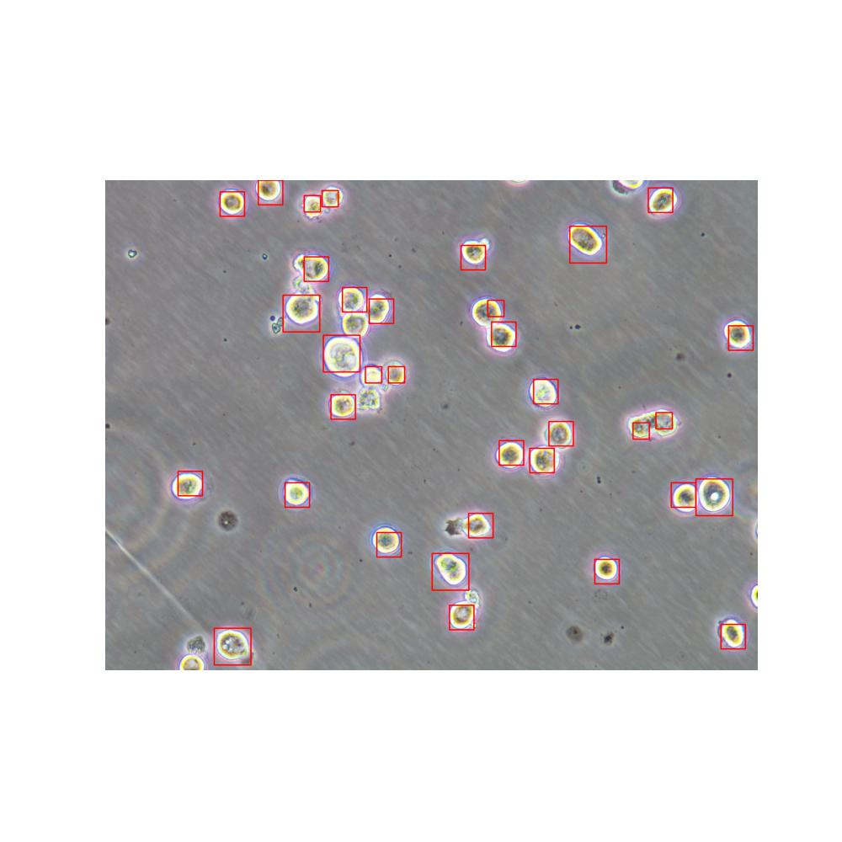
Results on Test Dataset (without transfer learning)

Slide 22
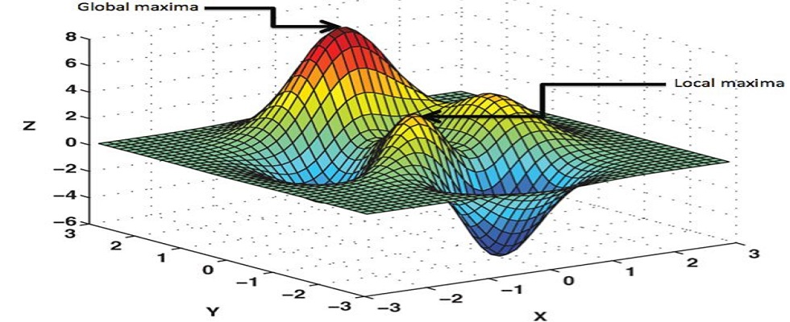
Deep Residual Learning for Image Recognition (ResNet) – December, 2015
Deep learning methods learn abstract representations of the data rather than relying on hand-engineered features. This allows them to automatically identify and leverage more complex patterns in the data that may not be easily captured by predefined features.
Deep neural networks have greater modeling capacity to fit complex functions compared to linear models like SVM. The multiple stacked layers allow deep nets to learn hierarchical feature representations from low to high level.

Slide 23
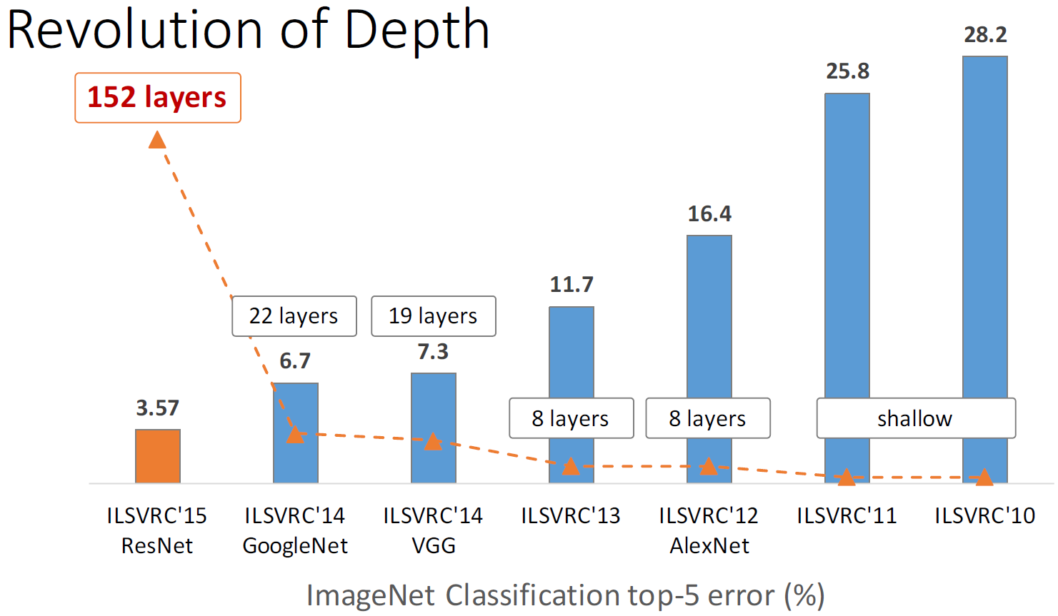
ResNet

Slide 24
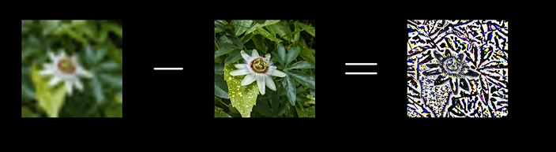
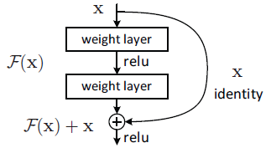
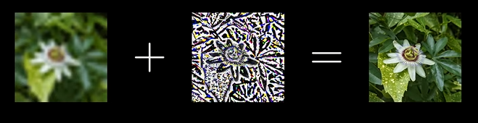
ResNet Intuition

Slide 25
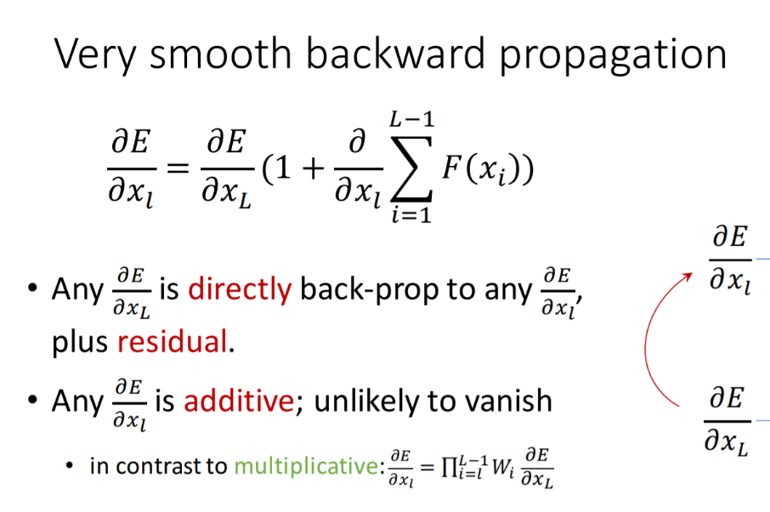
Backpropagation with ResNet

Slide 26
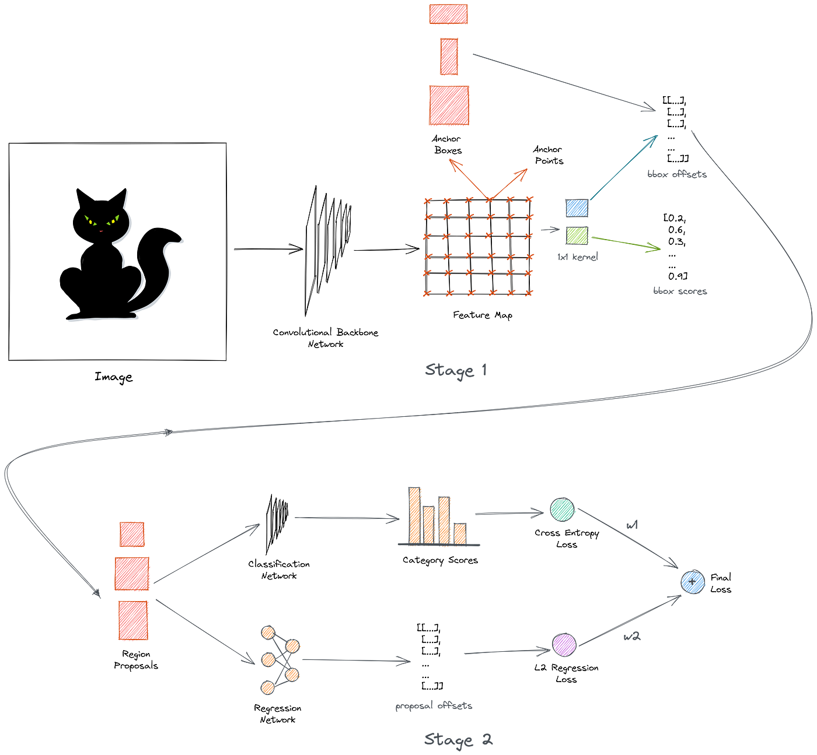
Faster RCNN (Using ResNet 50 backbone)
The Image first passes through the backbone network to get an output feature map, and the ground truth bounding boxes of the image get projected onto the feature map.
The backbone network is a dense convolutional network ResNet
We use a 1x1 convolutional network to predict the category and the offsets of all the anchor boxes.

Slide 27
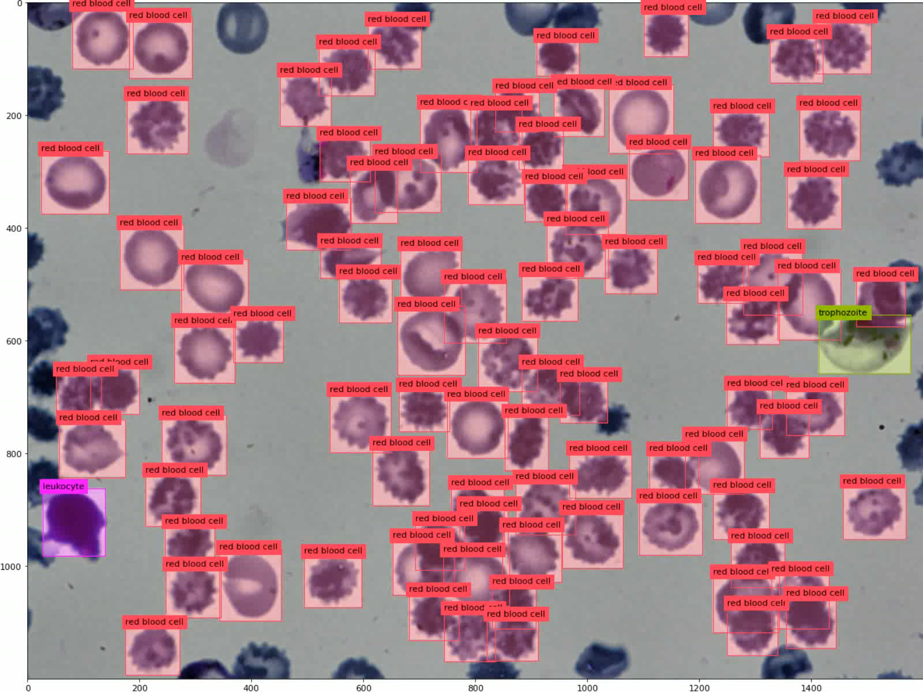
Results on Training Dataset

Slide 28
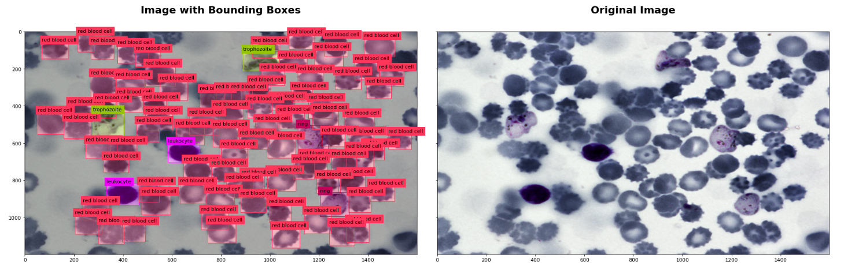
Results on Training Dataset

Slide 29
Results on Test Dataset

Slide 30
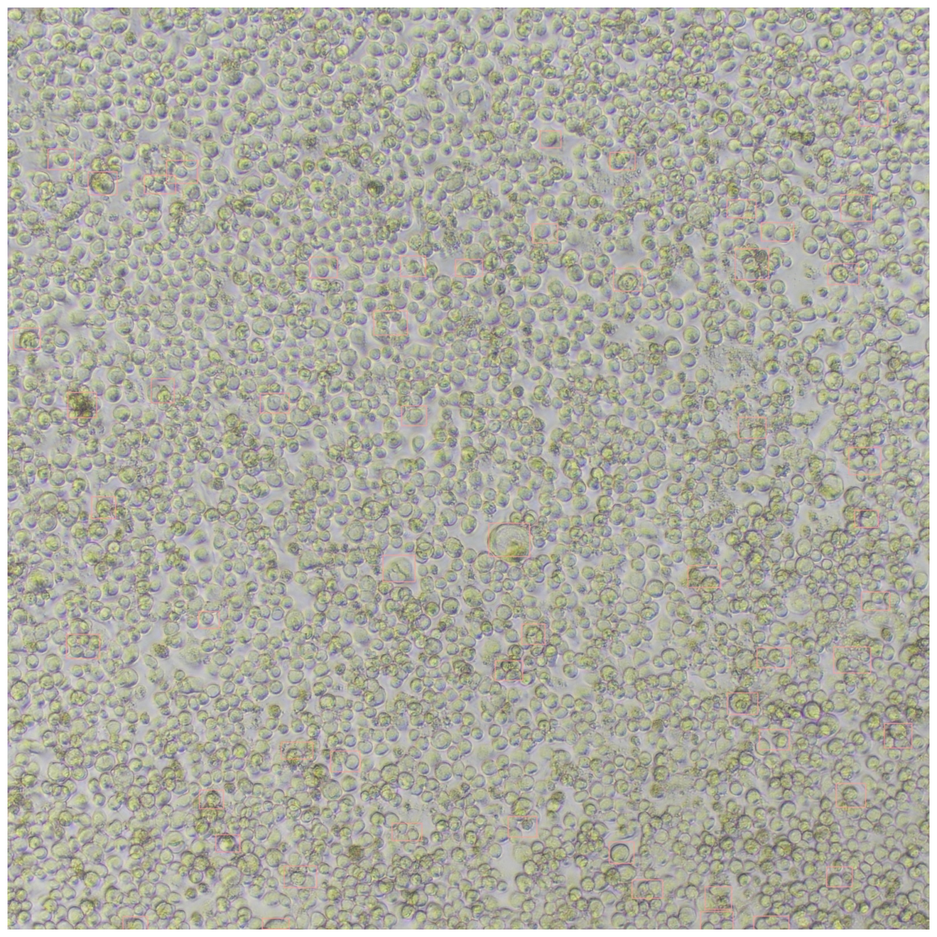
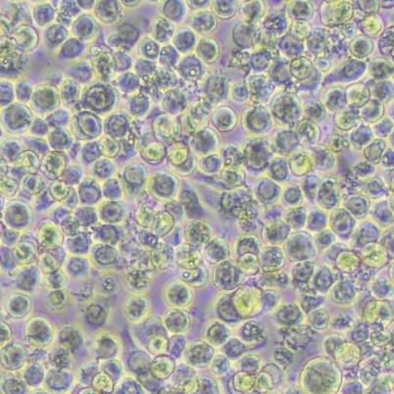
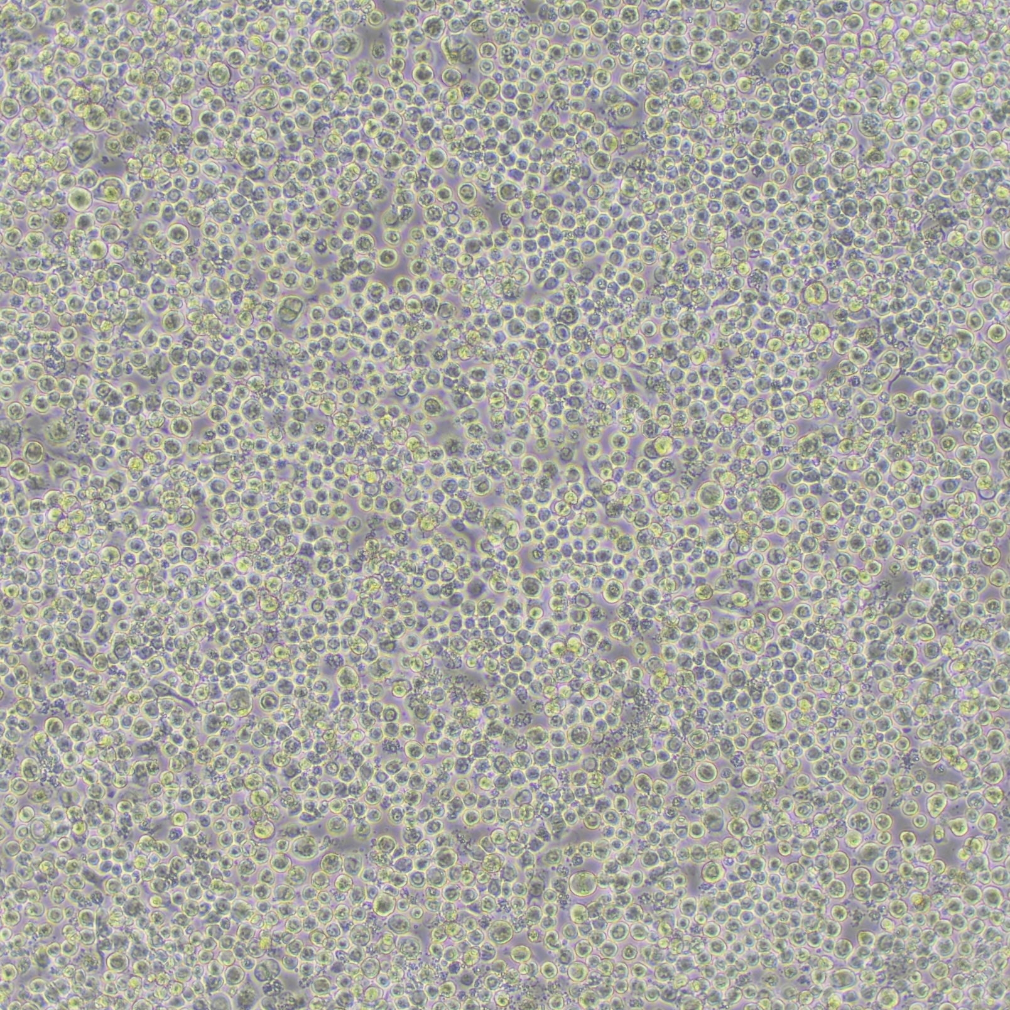
Visualizing our Data – SF21 Cells
Old Dataset
New Dataset

Slide 31
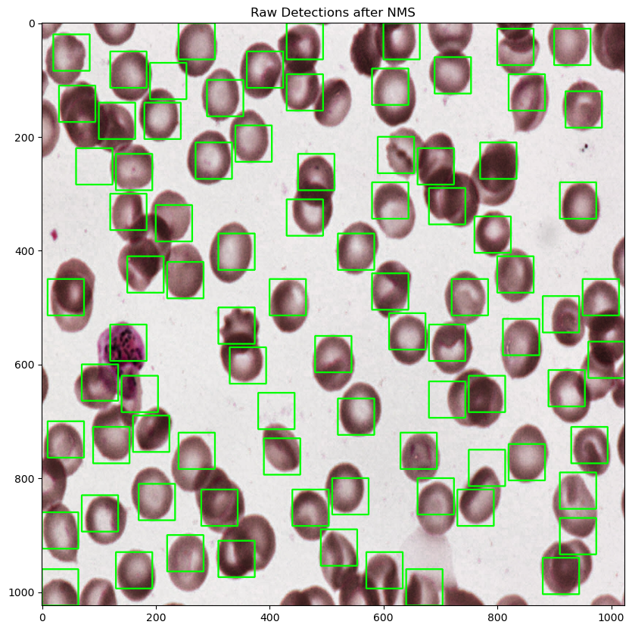
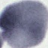
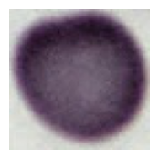
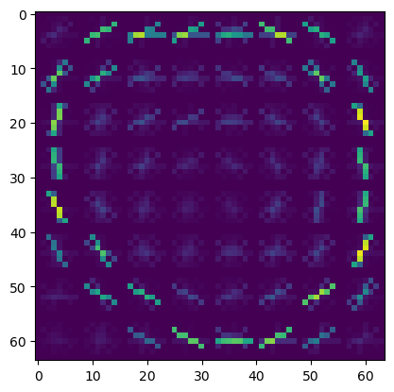
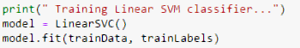

Approach for Object Detection
Prepare Dataset
Extract 64x64 images with Cell
Extract 64x64 images without cell
Extract Features
SURF- Speeded up robust features
Train Classifier
SVM
ResNet
HOG - Histogram of Oriented Gradients
LBP – Local Binary Pattern
BLOB - log
Sliding Window Approach
Change Image size
Sliding Window step size

Slide 32
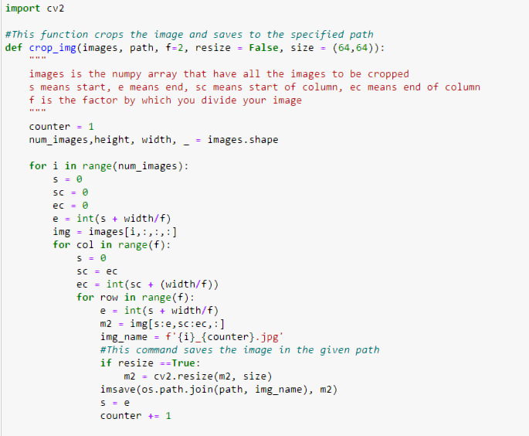
Cropping Images such that 64x64 pixel cell covers one cell
Dataset Size: Positive Image - 31692
Negative Images - 2400

Slide 33
Feature Extraction
HOG Algorithm
Histogram of oriented gradients

Slide 34
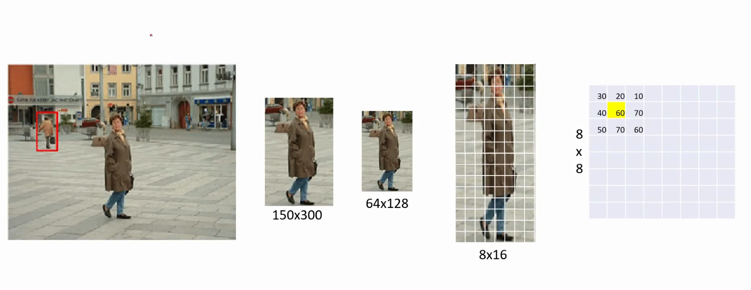
How does HOG work?

Slide 35
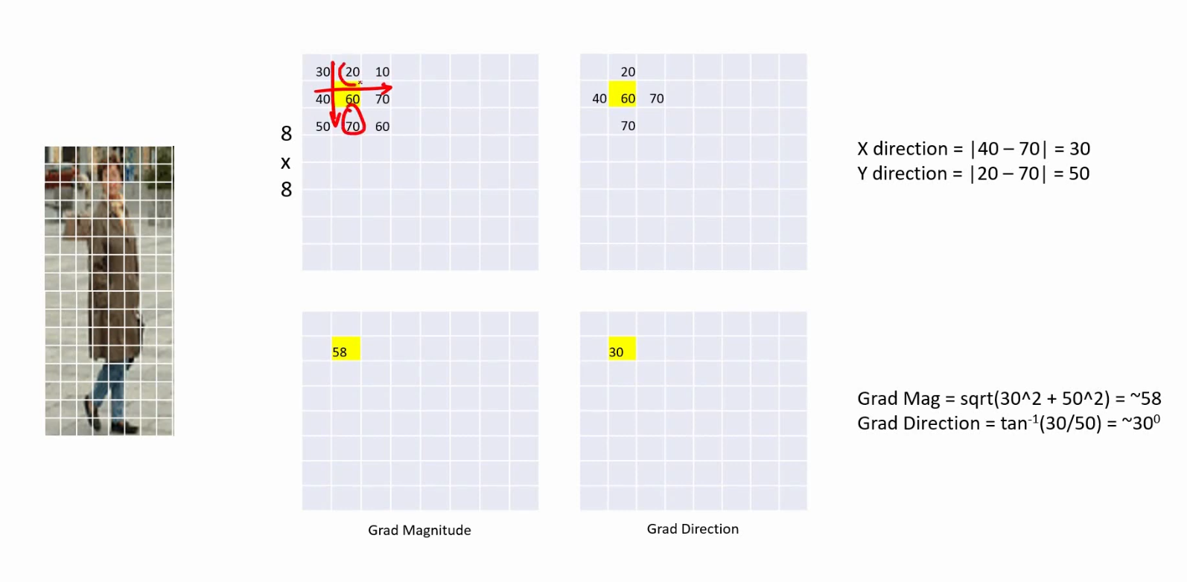
HOG – Gradient Calculation

Slide 36
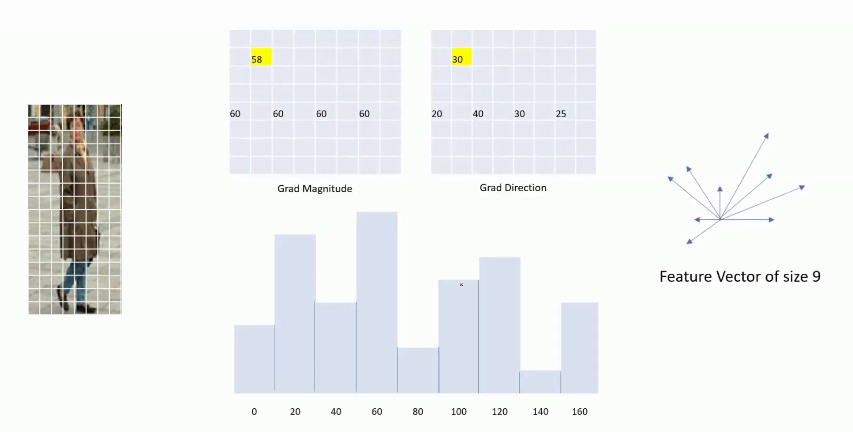
HOG- Feature Vector Calculation

Slide 37
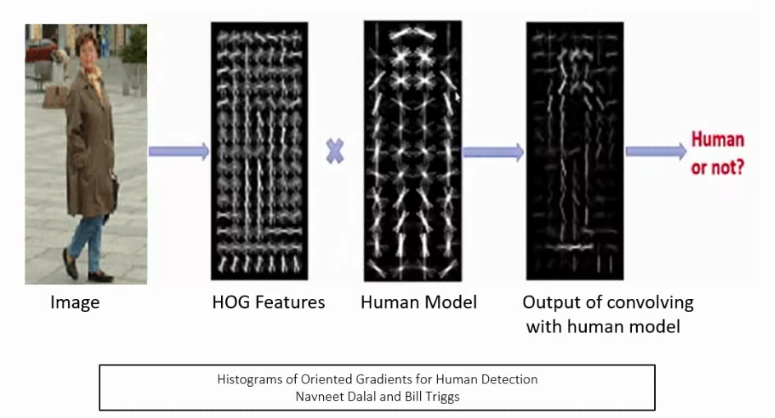
HOG – For object detection

Slide 38
Object Detection using Sliding Window

Slide 39
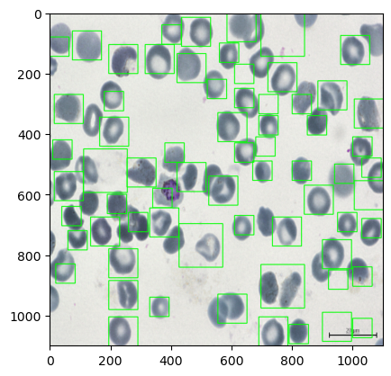
Results
Object Parameters:
Input image size
Downscale Value
Non Max Overlap Threshold
Confidence Score

Slide 40
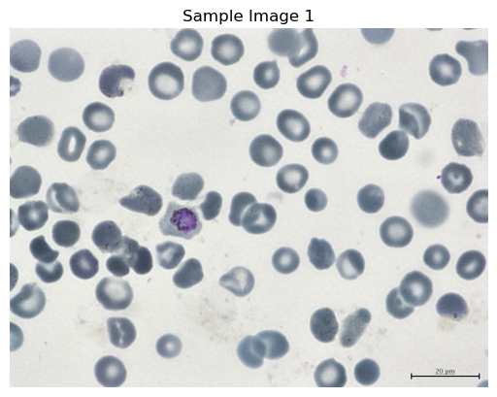
Input Image Size
256 x 256 Image
1100 x 1100 Image

Slide 41
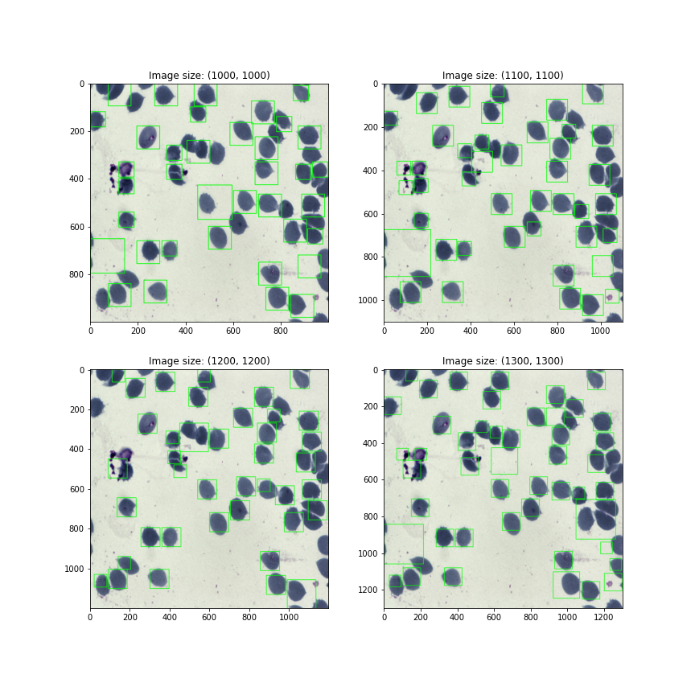
Results
Original Detection for
reference

Slide 42
Original Image
Final Image

Slide 43
Downscale Value
Step 1
Step 2
Step 3

Slide 44


Results
Keeping Downscale Value too low

Slide 46

Non Max Suppression
Non max suppression is a technique used mainly in object detection that aims at selecting the best bounding box out of a set of overlapping boxes.
In the following image, the aim of non max suppression would be to remove the red, and blue boxes, so that we are left with only the green box.

Slide 47

How does Non Max Suppression Work
Let us assume that for this particular image we have a list 3 bounding boxes; i.e bbox_list = [blue_box, yellow_box, green_box].
green_box = [x1, y1, x2, y2, ”Cat”, 0.9] yellow_box = [x5, y5, x6, y6, ”Cat”, 0.75] blue_box = [x3, y3, x4, y4, ”Cat”, 0.85]

Slide 48
As the first step in NMS, we sort the boxes in descending order of confidences. This gives us:
bbox_list = [green_box, blue_box, yellow_box]
We then define a confidence threshold. For this example, let us assume a confidence threshold of 0.8. Using this threshold, we would remove the yellow box as its confidence is < 0.8
bbox_list = [green_box, blue_box]
we know that the first box in the list has the highest confidence.We remove this first box from the list and add it to a new list. In our case we would remove the green box, and put it into a new list
bbox_list_new = [green]
we define an additional threshold for IOU. This threshold is used to remove boxes that have a high overlap. If two boxes have a significant amount of overlap, and they also belong to the same class, it is highly likely that both the boxes are covering the same object
IOU threshold is 0.5
now start calculating the IOU of the green box with every remaining box in the bbox_list that also has the same class. In our case we would calculate the IOU of the green box only with the blue box.
bbox_list_new = [green]

Slide 49


Slide 50

Result
Threshold of 1.3 has lower inaccuracies

Slide 51


Extracting Features using SURF
SURF or (Speeded-Up Robust Features)
Integral images
The Integral Image or Summed-Area Table was introduced in 1984. The Integral Image is used as a quick and effective way of calculating the sum of values (pixel values) in a given image — or a rectangular subset of a grid (the given image).
Hessian matrix-based interest points
Surf uses the Hessian matrix because of its good performance in computation time and accuracy. Rather than using a different measure for selecting the location and the scale (Hessian-Laplace detector), surf relies on the determinant of the Hessian matrix

Slide 52


Understanding Surf
In order to calculate the determinant of the Hessian matrix, first we need to apply convolution with Gaussian kernel, then second-order derivative.
After Lowe’s success with LoG approximations(SIFT), SURF pushes the approximation(both convolution and second-order derivative) even further with box filters. These approximate second-order Gaussian derivatives and can be evaluated at a very low computational cost using integral images and independently of size, and this is part of the reason why SURF is fast.
The 9 × 9 box filters in the above images are approximations for Gaussian second order derivatives with σ = 1.2. We denote these approximations by Dxx, Dyy, and Dxy.

Slide 53

Features or Interest points used
for comparison of two images
are identified

Slide 54

No. of features matches will be more if it is a close match,
otherwise no. of feature matches will be small

Slide 55





SURF
Edge Detection
Corner Detection

Slide 56


Neglect the patches on planes and edges, and only take Corner patches

Slide 57

Training SVM Model
Since SVM model requires fixed size of
Data points whereas number of features detected for each image is varying drastically, We use Principle Component Analysis (PCA) to reduce the dimension of
Our features.
For ex. Input dimension: (148, 70), (20, 70) Output Dimension: (10,70), (10,70)

Slide 58

Training Results

Slide 59


Changing the Sliding Window Approach

Slide 60

Using ResNet Instead of SVM

Slide 61
Roadmap to learn Object Detection
2005 - [HOG, SIFT, Edge, Corner, Colour...]
Selective Search
Edge Boxes
[AlexNet, VGGNet, ZFNet, ResNet]
Dalal & Triggs Detector
2010 - DPM
2013 - [Region Proposal Networks]
Overfeat
R-CNN
Spatial Pyramid Pooling Network
FAST RCNN
Faster RCNN
R FCN
SSD (2016)
2016 - YOLO
2017 - Retina Net
feature extraction, object detection, edge detection
Human detection in images based on Histogram of Oriented Gradients (HOG) features and linear Support Vector Machine (SVM) classifier
DPM stands for Deformable Part-based Model, which is a method for object detection in computer vision.
2015 - Convolutional Neural Network (CNN) architectures
2014 - Localizaton
CNN-based image classifier and feature extractor, developed by Pierre Sermanet, David Eigen, Xiang Zhang, Michael Mathieu, Rob Fergus, and Yann LeCun. It was the winner of the localization task and a strong contender for the classification and detection tasks of the ImageNet 2013 challenge
2014 - Classificaton + Localization
2015-2016 Object Detection
Single Shot MultiBox Detector, Does not require region proposal

